Slide 1

Team: RoboDucks
Automation Challenge - Shortest Path
RPA League: 36-Hour Hackathon

Slide 2
AGENDA
Team description
Why Ui Path Brief ?
Solution description
Challenges and solutions
Improvements
Q&A

Slide 3
Team members
Andreea Curcan
Andreia Ciocanel
Alex Fierascu
Marius Birsan

Slide 4
Why Ui Path brief?
Challenging
No initial clear cut solution
OCR unpredictable results

Slide 5
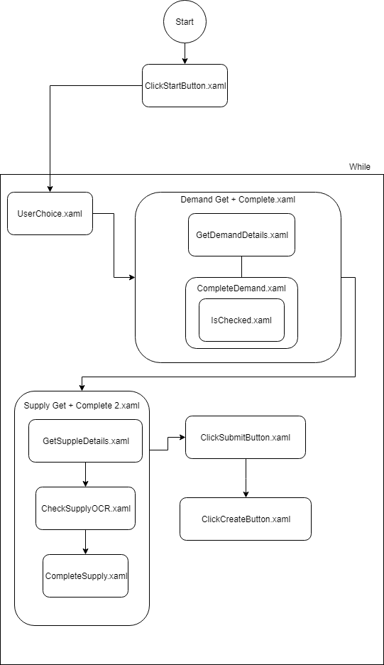
Solution description

Slide 6
Challenges and solutions
OCR
Unexpected computing method for end results
Github versioning

Slide 7
Improvements
Improvements
There can never be enough Try catches! (however in the spirit of a speedy implementation, this can be added at a later time)
More testing
Future development :
Shortest path algorithm so the robot would become an unattended one from an attended one.
A better processing of the data - more cases treated in the case of OCR or selectors failure
Robot starting from Orchestrator.
We could extend this application to monitor carbon footprint using external public services called from an API.

Slide 8
Q & A

